Slide 1
Power BI Desktop
First contact
Power BI Desktop
First contact

Slide 2
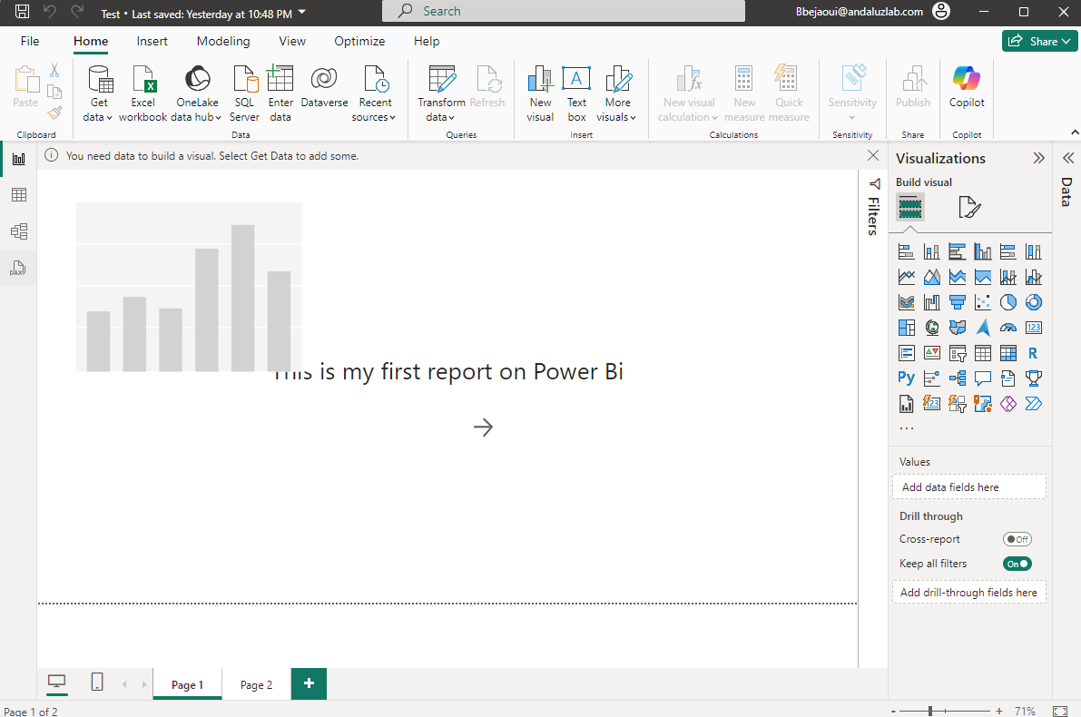
Report design scene

Slide 3
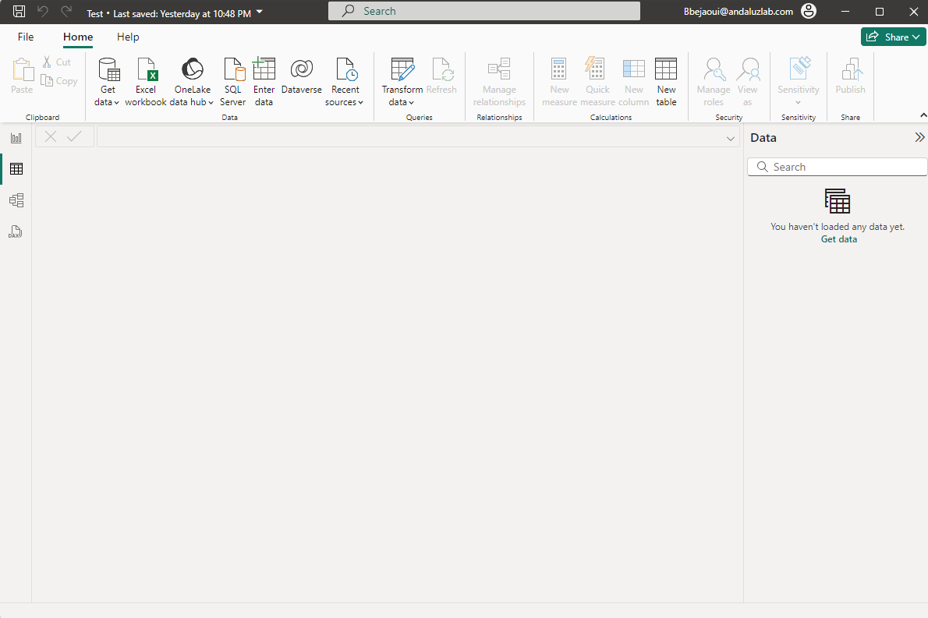
Tables & data

Slide 4
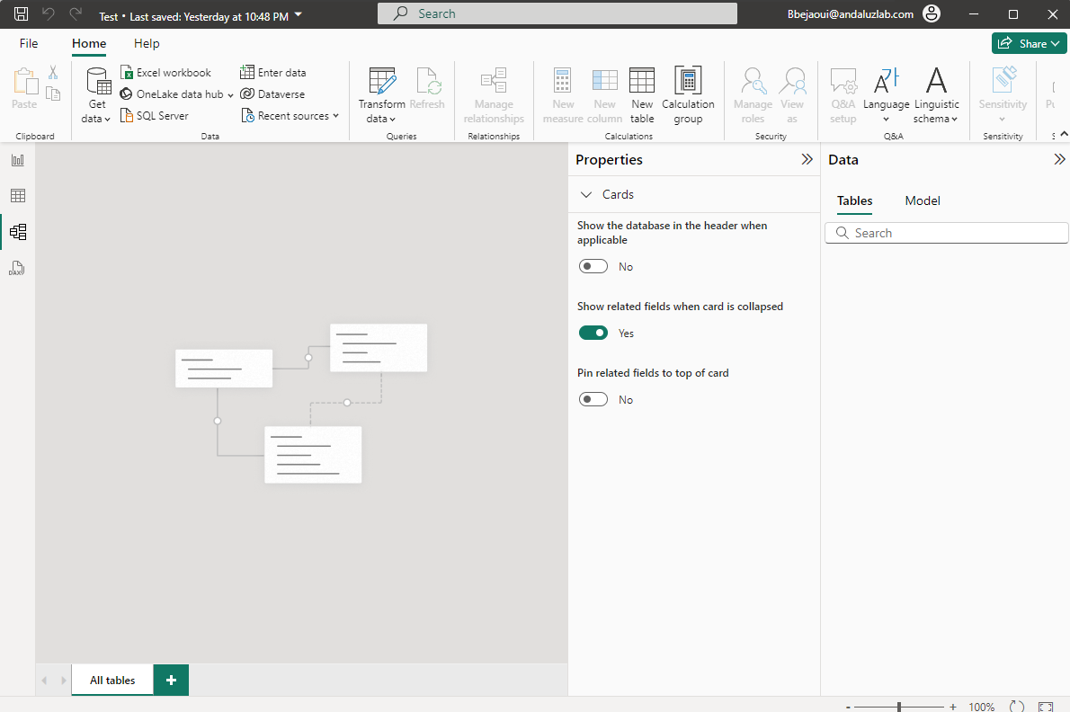
Modelization

Slide 5
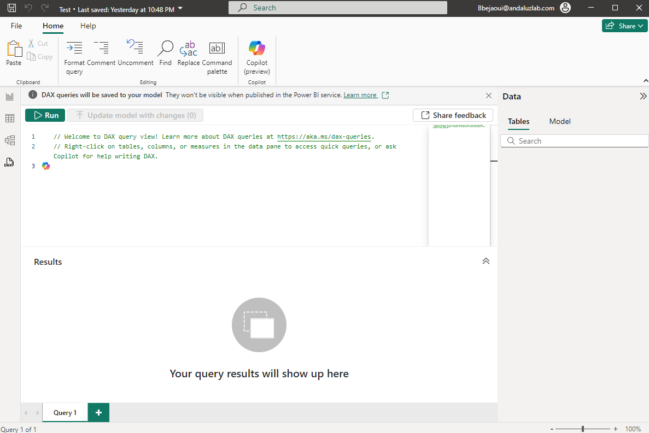
DAX Formulat Editor

Slide 6
Thank you
Thank you

